Slide 1


Slide 2
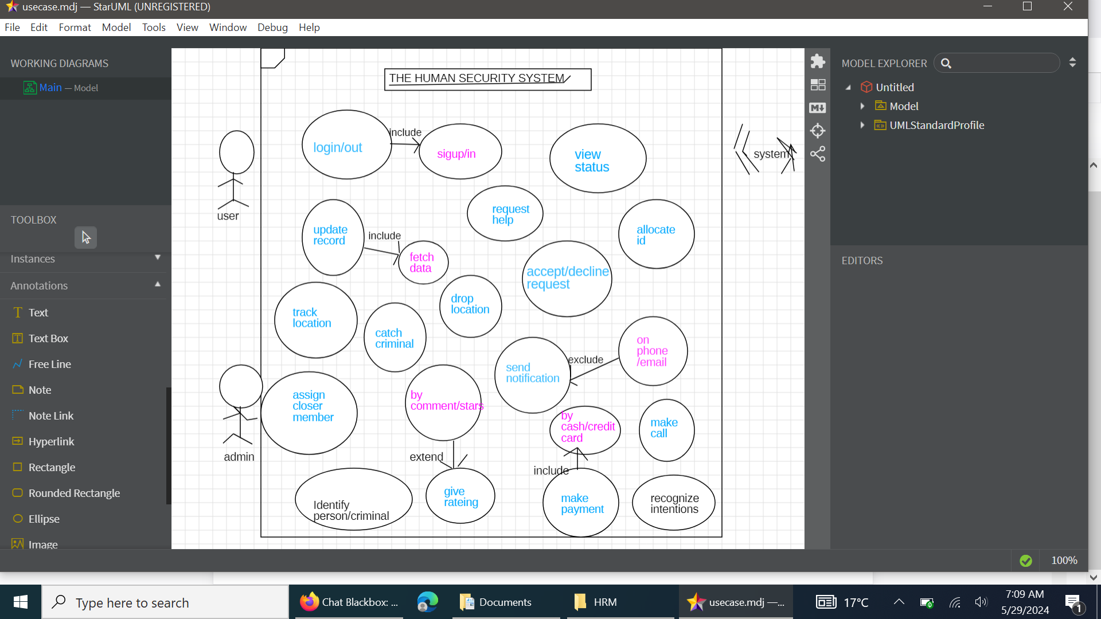

Slide 3
CODE
// Interface for location allocation
interface LocationAllocator {
void allocateLocation(User user);
}
// Class representing a User
class User {
private String name;
private String preferredLocation;
public User(String name, String preferredLocation) {
this.name = name;
this.preferredLocation = preferredLocation;
}
public String getName() {
return name;
}
public String getPreferredLocation() {
return preferredLocation;
}
}
// Class for allocating locations based on user preferences
class PreferredLocationAllocator implements LocationAllocator {
@Override
public void allocateLocation(User user) {
System.out.println("Allocating preferred location for " + user.getName() + ": " + user.getPreferredLocation());
}
}
// Class for allocating a default location if no preference is set
class DefaultLocationAllocator implements LocationAllocator {
@Override
public void allocateLocation(User user) {
System.out.println("Allocating default location for " + user.getName() + ": Default Location");
}
}
// Class to manage the allocation process
class LocationManager {
private LocationAllocator allocator;
public LocationManager(LocationAllocator allocator) {
this.allocator = allocator;
}
public void setAllocator(LocationAllocator allocator) {
this.allocator = allocator;
}
public void allocate(User user) {
allocator.allocateLocation(user);
}
}
// Main class to demonstrate the allocation
public class Main {
public static void main(String[] args) {
User user1 = new User("Alice", "Downtown");
User user2 = new User("Bob", null);
LocationManager manager = new LocationManager(new PreferredLocationAllocator());
manager.allocate(user1);
// Switch to default allocator for user2
manager.setAllocator(new DefaultLocationAllocator());
manager.allocate(user2);
}
}
Explanation of the Code
Single Responsibility Principle (SRP): Each class has a specific responsibility. User holds user information, PreferredLocationAllocator allocates based on preferences, and DefaultLocationAllocator allocates a default location.
Open/Closed Principle (OCP): The LocationAllocator interface allows for new allocation strategies to be added without modifying existing code. You can create new classes that implement LocationAllocator without changing the LocationManager.
Liskov Substitution Principle (LSP): Any class that implements LocationAllocator can be used interchangeably in LocationManager.
Interface Segregation Principle (ISP): The LocationAllocator interface is focused on a single responsibility (location allocation), ensuring that clients only implement methods they need.
Dependency Inversion Principle (DIP): LocationManager depends on the abstraction LocationAllocator, not on concrete implementations. This allows for easy swapping of allocation strategies.
This structure provides a flexible and maintainable design for a location allocation system, following SOLID principles.

